Slide 1

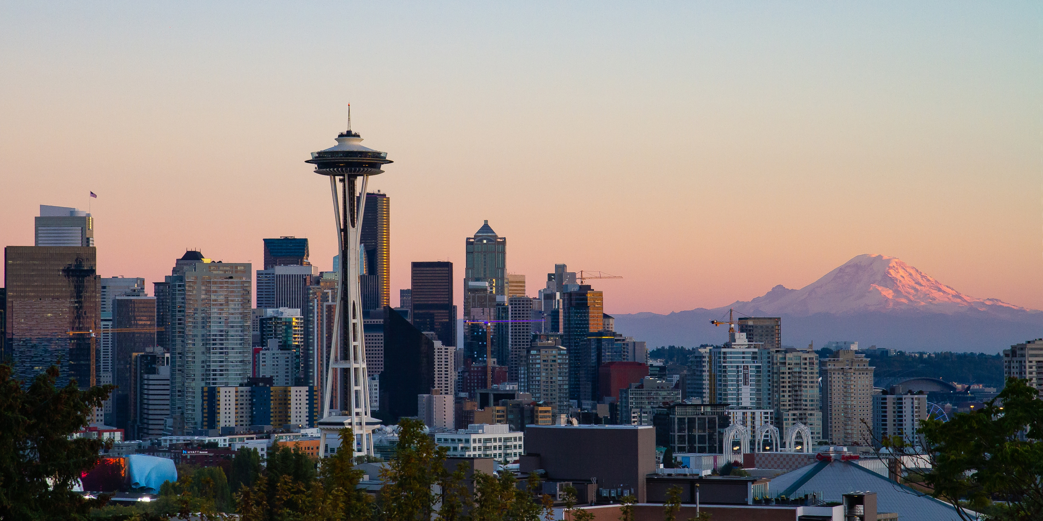
Jiajie Guo
Yue wang
Yuqi Zheng
Zhicheng Ju
Photo resource: https://en.wikipedia.org/wiki/Seattle

Slide 2
Outline
Background
Data
Use cases
Demo
Design
Project Structure
Lessons learned and future work

Slide 3
Background
Parking has been a normal issue in our daily life
Downtown has more vehicles with limited parking lots
Spend less time in looking for parking
Develop a tool to help users to park by giving the best parking location based on the user's location

Slide 4
Data
Annual Parking Study Data of Seattle
Manual parking study details from citywide paid parking study, presented by blockface and date/hour of study.
Blockface
Displays blockfaces for all segments of the street network. Identifies the elements of the block, such as peak hour restrictions, length of the block, parking categories, and restricted parking zones.
EV_Charger
Display charging station details and distribution within Washington State.
Seattle Streets
Shows detail information on streets of downtown Seattle, such as longitude, latitude, slope and length of the streets.

Slide 5
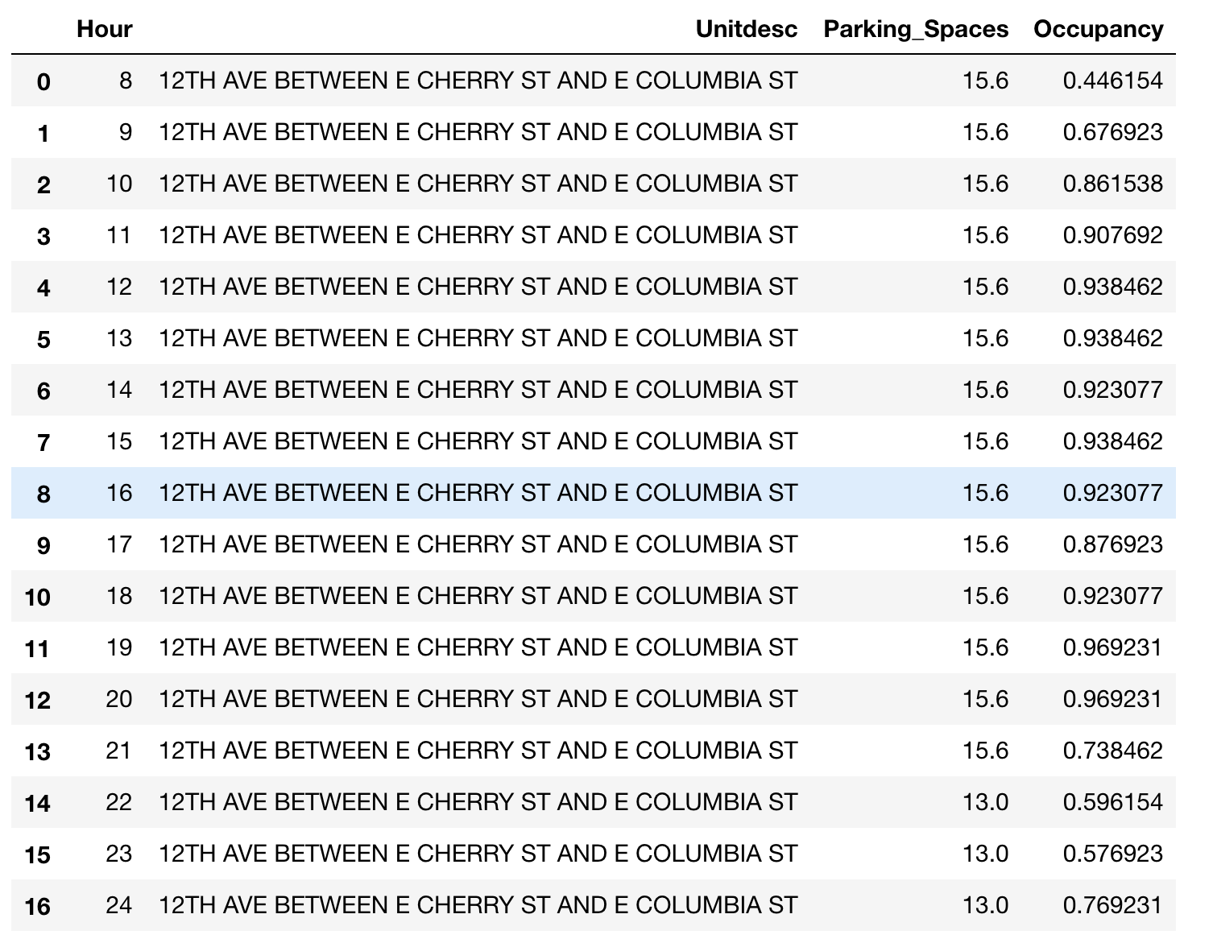
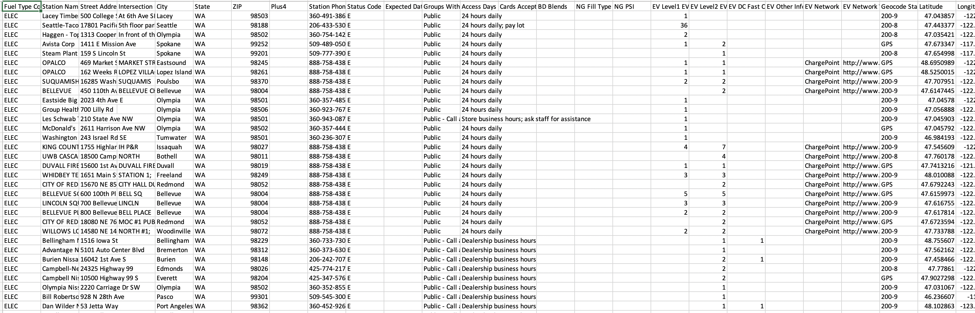
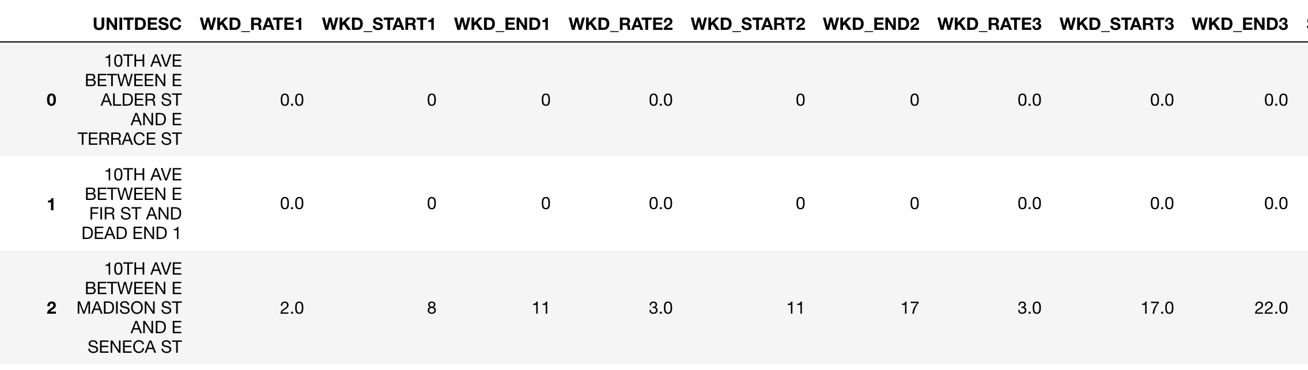
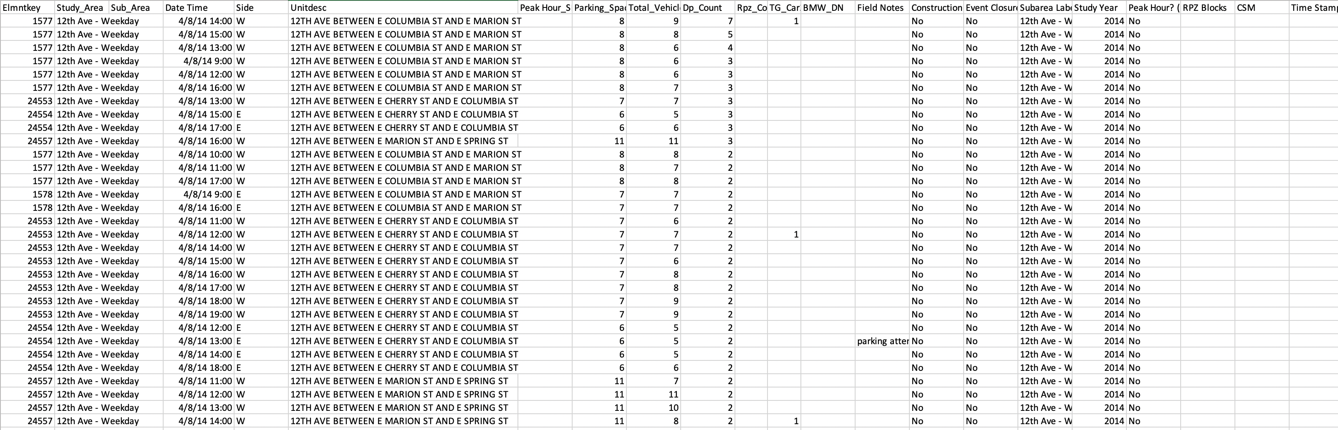
Data

Slide 6
Data

